Slide 1
Regression Analysis
Logistic Regression
Nicoleta Serban, Ph.D.
Professor
Stewart School of Industrial and Systems Engineering
Model Description and Estimation

Slide 2

About This Lesson

Slide 3
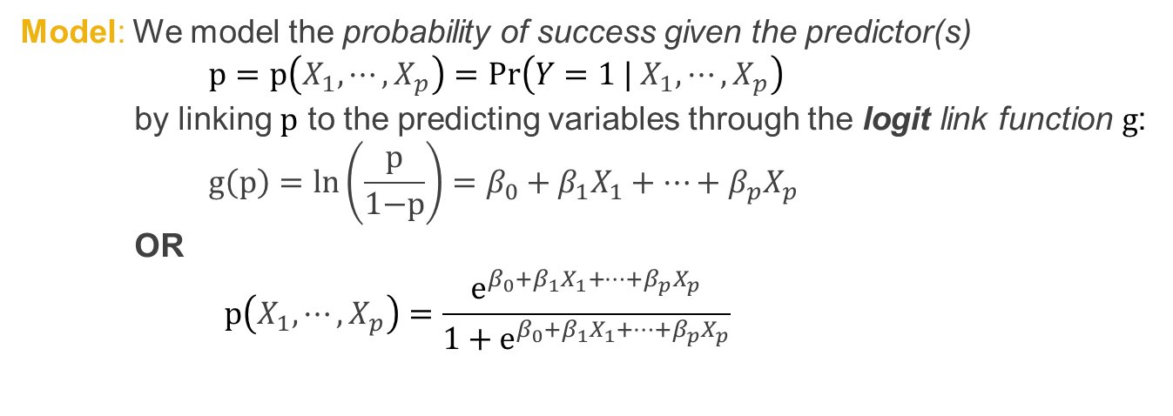
Logistic Regression Model
Data: $\left\{\left(X_{1,1},X_{1,2},⋯,X_{1,p}\right),Y_{1}\right\},\left\{\left(X_{2,1},X_{2,2},⋯,X_{2,p}\right),Y_{2}\right\},⋯,\left\{\left(X_{n,1},X_{n,2},⋯,X_{n,p}\right),Y_{n}\right\}$
where $Y_{1},⋯,Y_{n}$ are binary responses
Model: We model the probability of success given the predictor(s)
$$p=p\left(X_{1},⋯,X_{p}\right)=Pr\left(Y=1 |{ X}_{1},⋯,X_{p}\right)$$
by linking $p$ to the predicting variables through the logit link function $g$:
$$g\left(p\right)=ln\left(\frac{\text{p}}{\text{1−}\text{p}}\right)=β_{0}+β_{1}X_{1}+⋯+β_{p}X_{p}$$
OR
$$p\left(X_{1},⋯,X_{p}\right)=\frac{e^{β_{0}+β_{1}X_{1}+⋯+β_{p}X_{p}}}{1+e^{β_{0}+β_{1}X_{1}+⋯+β_{p}X_{p}}}$$

Slide 4
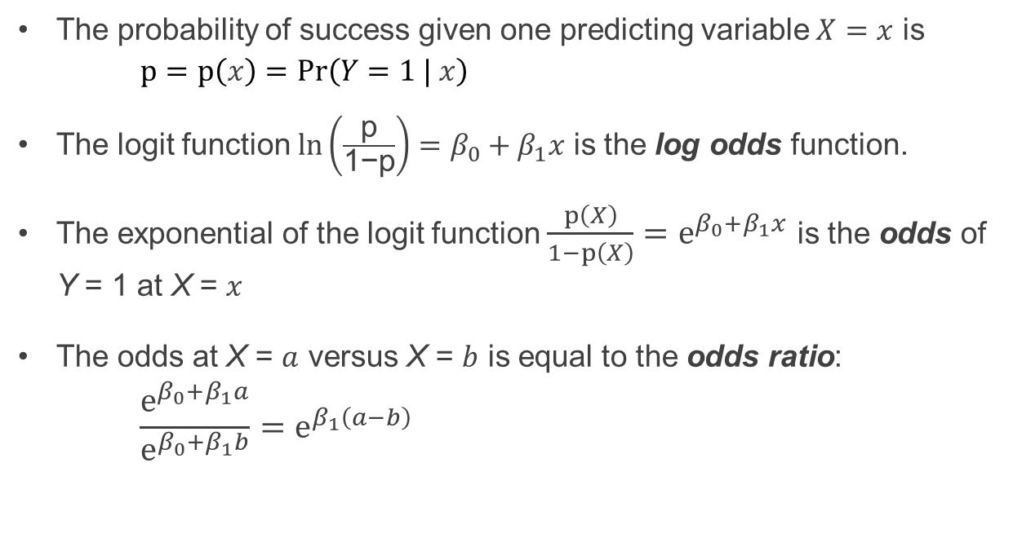
Model Interpretation
The probability of success given one predicting variable $X=x$ is
$$p=p\left(x\right)=Pr\left(Y=1 | x\right)$$
The logit function $ln\left(\frac{\text{p}}{\text{1−}\text{p}}\right)=β_{0}+β_{1}x$ is the log odds function.
The exponential of the logit function $\frac{p\left(X\right)}{1−p\left(X\right)}=e^{β_{0}+β_{1}x}$ is the odds of Y = 1 at X = $x$
The odds at X = $a$ versus X = $b$ is equal to the odds ratio:
$$\frac{e^{β_{0}+β_{1}a}}{e^{β_{0}+β_{1}b}}=e^{β_{1}\left(a−b\right)}$$

Slide 5
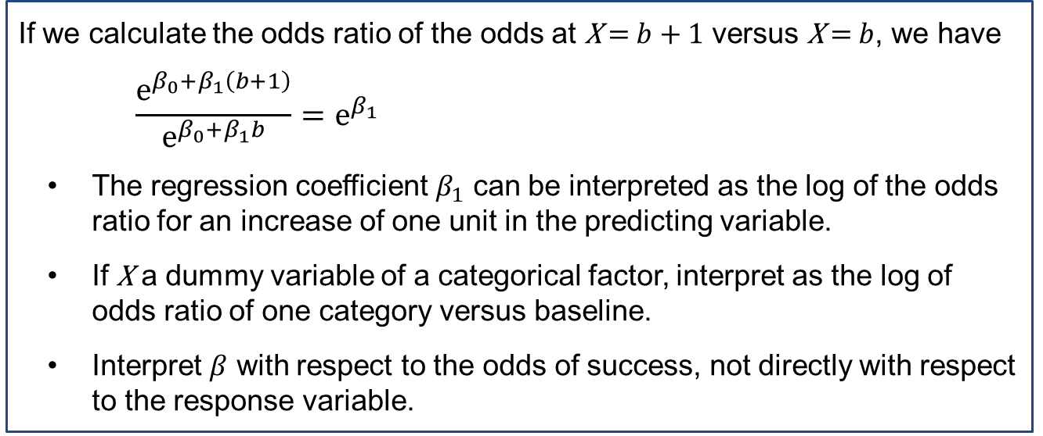
Model Interpretation
If we calculate the odds ratio of the odds at X = $b+1$ versus X = $b$, we have
$$\frac{e^{β_{0}+β_{1}\left(b+1\right)}}{e^{β_{0}+β_{1}b}}=e^{β_{1}}$$
The regression coefficient $β_{1}$ can be interpreted as the log of the odds ratio for an increase of one unit in the predicting variable.
If X a dummy variable of a categorical factor, interpret as the log of odds ratio of one category versus baseline.
Interpret $β$ with respect to the odds of success, not directly with respect to the response variable.

Slide 6
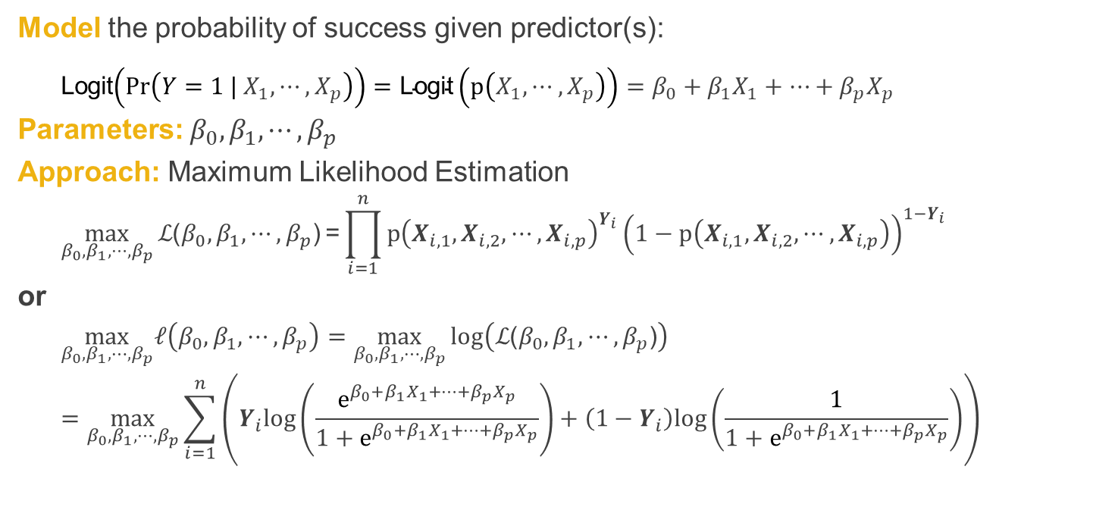
Model Estimation
Model the probability of success given predictor(s):
Logit$\left(Pr\left(Y=1 |{ X}_{1},⋯,X_{p}\right)\right)=\text{Logit}\left(p\left(X_{1},⋯,X_{p}\right)\right)=β_{0}+β_{1}X_{1}+⋯+β_{p}X_{p}$
Parameters: $β_{0},β_{1},⋯,β_{p}$
Approach: Maximum Likelihood Estimation
$$\max_{β_{0},β_{1},⋯,β_{p}}{ℒ\text{(}β_{0},β_{1},⋯,β_{p}\text{)}}\text{=}\prod_{i=1}^{n}{p{\left(X_{i,1},X_{i,2},⋯,X_{i,p}\right)}^{Y_{i}}}{\left(1−p\left(X_{i,1},X_{i,2},⋯,X_{i,p}\right)\right)}^{1−Y_{i}}$$
or
$$\max_{β_{0},β_{1},⋯,β_{p}}ℓ\left(β_{0},β_{1},⋯,β_{p}\right)=\max_{β_{0},β_{1},⋯,β_{p}}{log\left(ℒ\text{(}β_{0},β_{1},⋯,β_{p}\text{)}\right)}$$
$$=\max_{β_{0},β_{1},⋯,β_{p}}{\sum_{i=1}^{n}{\left(Y_{i}log\left(\frac{e^{β_{0}+β_{1}X_{1}+⋯+β_{p}X_{p}}}{1+e^{β_{0}+β_{1}X_{1}+⋯+β_{p}X_{p}}}\right)+\left(1−Y_{i}\right)log\left(\frac{1}{1+e^{β_{0}+β_{1}X_{1}+⋯+β_{p}X_{p}}}\right)\right)}}$$

Slide 7
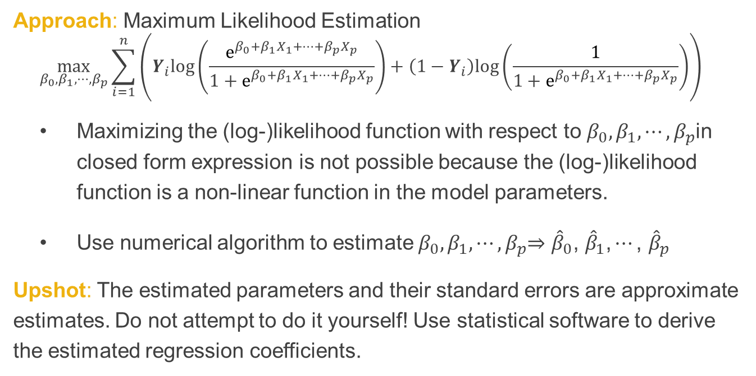
Model Estimation (cont’d)
Approach: Maximum Likelihood Estimation
$$\max_{β_{0},β_{1},⋯,β_{p}}{\sum_{i=1}^{n}{\left(Y_{i}log\left(\frac{e^{β_{0}+β_{1}X_{1}+⋯+β_{p}X_{p}}}{1+e^{β_{0}+β_{1}X_{1}+⋯+β_{p}X_{p}}}\right)+\left(1−Y_{i}\right)log\left(\frac{1}{1+e^{β_{0}+β_{1}X_{1}+⋯+β_{p}X_{p}}}\right)\right)}}$$
Maximizing the (log-)likelihood function with respect to $β_{0},β_{1},⋯,β_{p}$in closed form expression is not possible because the (log-)likelihood function is a non-linear function in the model parameters.
Use numerical algorithm to estimate $β_{0},β_{1},⋯,β_{p}$⇒ ${\hat{β}}_{0}\text{, }{\hat{β}}_{1}\text{,}⋯\text{, }{\hat{β}}_{p}$
Upshot: The estimated parameters and their standard errors are approximate estimates. Do not attempt to do it yourself! Use statistical software to derive the estimated regression coefficients.

Slide 8

Summary

